Slide 1


ICM Advanced Field Guide for ADMINISTRATORS
Thank you once again for choosing Icm and Relias on fulfilling your employee education and development needs

Slide 2
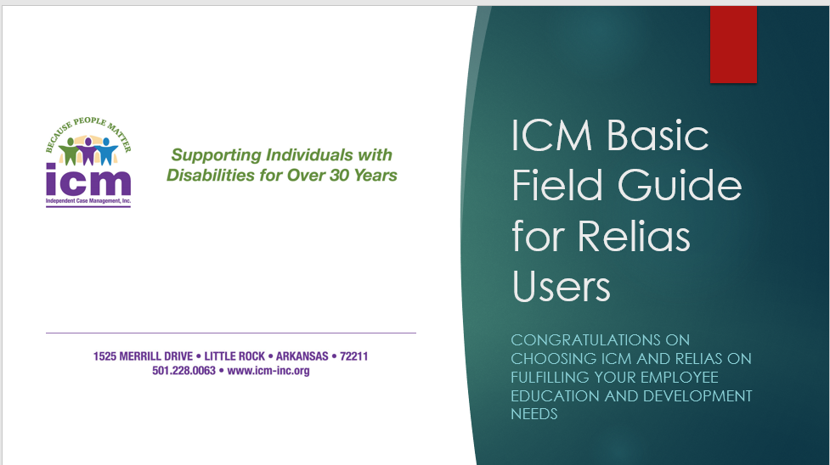
Please only refer to this field guide if you are an Administrator and only after viewing the basic field guide.

Slide 3
This guide will teach you:
How to access your supervisor account
How to add employees or staff individually
How to access reports
How to browse training plans and modules
How to enroll users into courses or plans
How to manage users and accounts
How to utilize Excel to mass import users

Slide 4
How to access your Administrator account
Go to https://www.relias.com/
Click “Login” at the top right of the page
Click “Relias Learning Login”
Enter your credentials into the username and password fields
You should automatically be assigned as a supervisor role if you worked with ICM during onboarding

Slide 5
How to add employees or staff individually
Click the “Users” tab to the left of your main page and click user list
Click the dark grey box titled “+New User”
Enter all required information to input your new user (Name, User Name, Password, Contact Info, and Organization. Other Fields do not need to be filled out) and hit “save” on the top right of the page.
ICM recommends using NOTHING that can identify an employee personally as their username. “Employee1234” or something similar is preferable to create anonymity.
ICM recommends always using the same password for all accounts that way there is initial consistency and if someone forgets their password before login the default one will always be known.

Slide 6
*****Important question*****
How can you mass notify users of Relias login?
Click on “Settings” on the overview tab
Scroll down and click “Email Templates”
Under “Type*”, select “Relias Account Information” and select “Yes” under “Approved” below
Here you can change the password to your default password for all new users. The system will automatically change the name, username, and organization for you so don’t change those.
Go back to your User List, check the box under “Filter By” to select all users, finally click “Activate” next to the box to send out a mass email to notify your users of their login information.

Slide 7
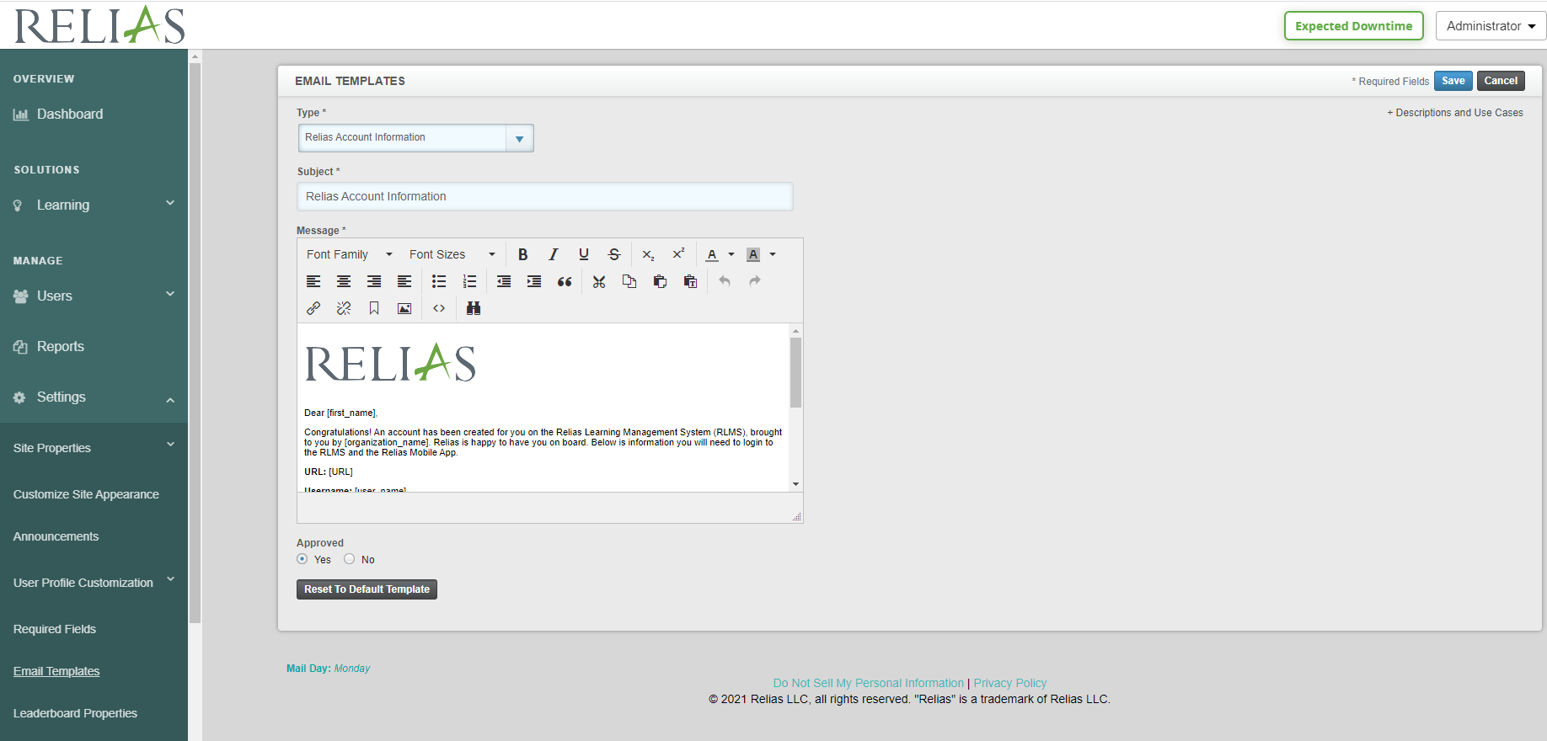
*****Important question***** (Continued)
How can you mass notify users of Relias login?

Slide 8
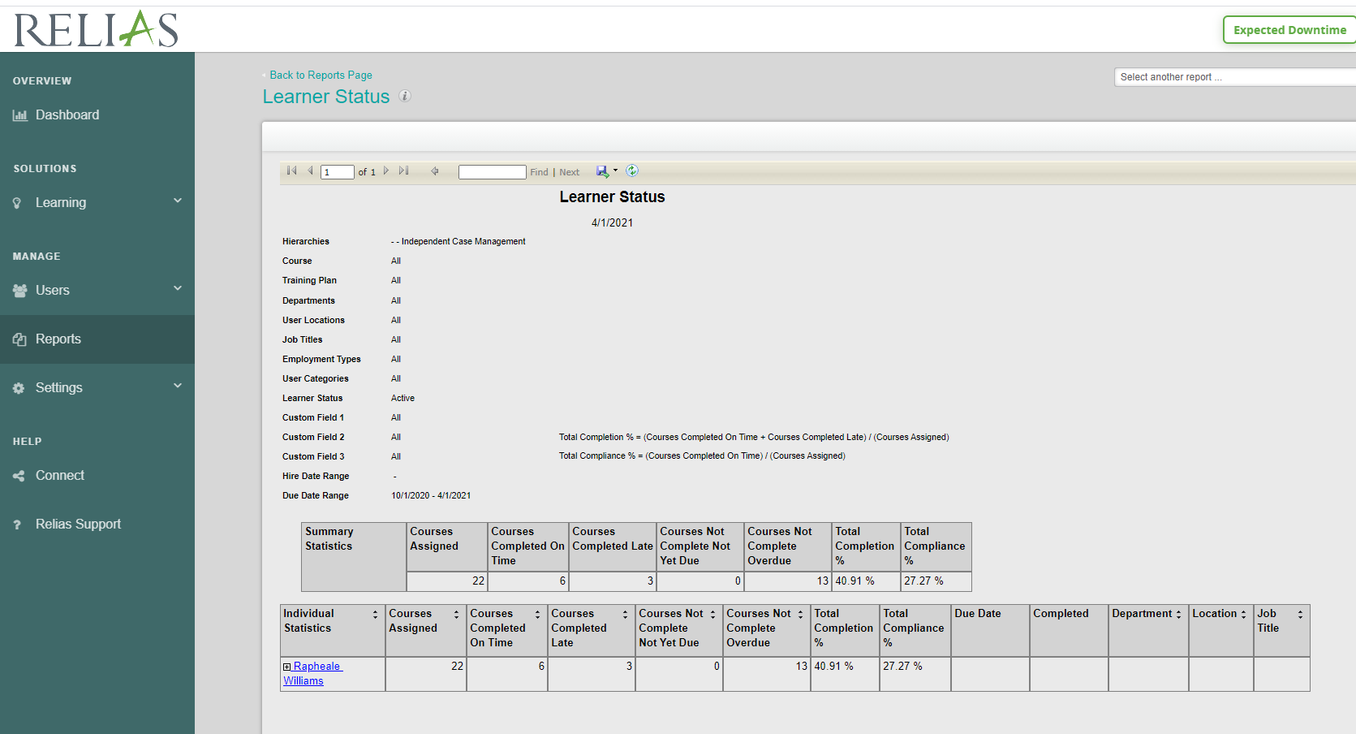
How to access Employee reports
Go to your dashboard and click “Reports” to the left of the screen
Click on “Create Report” and once more on “Module Enrollments and Completions”
For completion history clock on “Learner Status”
Always select your organization under Hierarchy
Click “Run Report” to see the report for all of your learners in your organization
If you would like to see other reports, make sure to select it in the selection screen

Slide 9
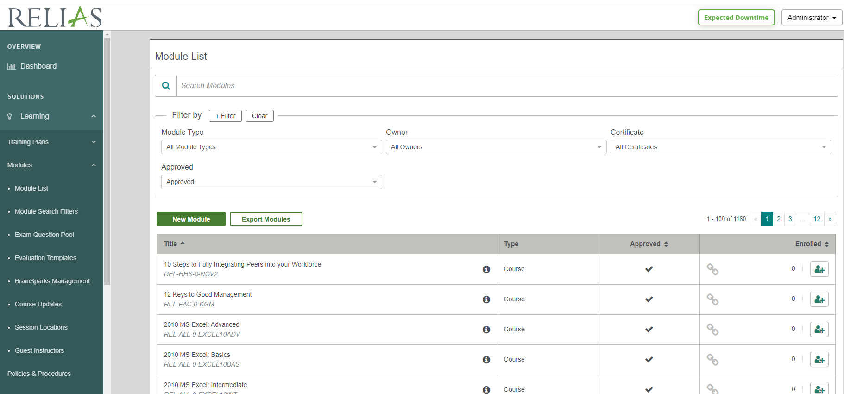
How to browse Learning Modules
Click “Modules” to the left bar, click “Module List”
This page will allow you to search all available modules
Enrolling into modules will not affect cost as long as it is in the library of modules

Slide 10
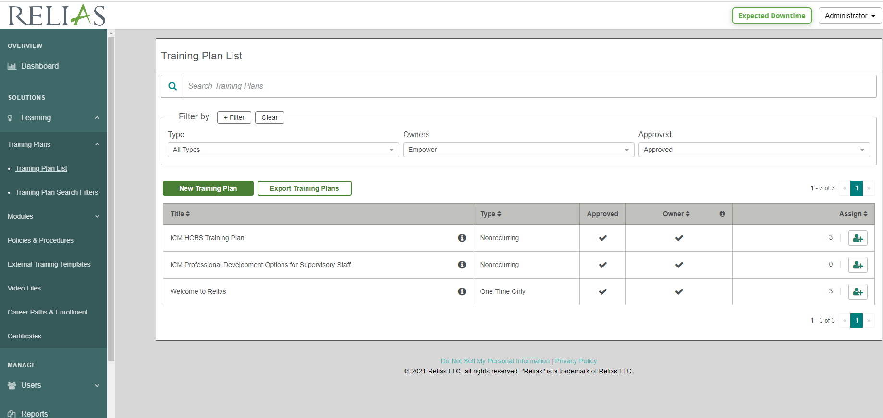
How to browse Training Plans
Select “Learning” on the left bar
Select “Training Plans” below
Select “Training Plan List” below that
To find Empower trainings, select “Empower” under the Owners Tab.
Most Learners will need to be enrolled in the ICM Empower HCBS Training Plan for Existing Providers (12 hours of training)
If you are a new provider or if your employee has no training at all, please enroll the employee into the ICM Empower HCBS Training Plan for New Providers
Most Supervisors may want to be enrolled into the Professional Development Options for Supervisory Staff for supplemental training
You can enroll staff with the + box to the right of the training plan
Then click the “Enrollment tab” and scroll down to select and enroll an individual

Slide 11
How to enroll users into Learning plans
Select “Learning” on the left bar
Select “Training Plans” below
Select “Training Plan List” below that
To find Empower trainings, select “Empower” under the Owners Tab.
Most Learners will need to be enrolled in the HCBS Training Plan
Most Supervisors will need to be enrolled into the Professional Development Options for Supervisory Staff
You can enroll staff with the + box to the right of the training plan
Then click the “Enrollment tab” and scroll down to select and enroll an individual

Slide 12
How to Enroll in Modules
Click “Modules” to the left bar, click “Module List” then select which module you want to add a user into.
Click the + box to the right of the module
Click the “Enrollment” tab
Select which users you want to enroll by clicking the box next to their name, then click the “Enroll” tab

Slide 13
How to manage users and accounts
Go to your “Dashboard” on the left
Click “Users”
Click “User List”
Click on the username that you want to manage. From here you can edit all information as necessary for the user. Primarily this page will be used to update information about someone’s account or to change a password that they might have forgotten.

Slide 14
How to utilize Excel to mass import users
This method should only be utilized for very large organizations over 50 users. If your organization is smaller than that number, ICM recommends that you input users into Relias individually.
Please access the “Import Spreadsheet Original.XLS” document provided to you by ICM
Click the “Data” tab below. It can be found in between the “Examples” and “Roles” tabs
Columns highlighted in White-Required
Columns highlighted in Blue-Highly Recommended - especially for auto enrollments
Columns in Black-Optional
Yellow indicates field will be removed if left blank on your sheet

Slide 15
Tips for using mass upload excel sheet
Never use usernames that can be associated with an employee. ESPECIALLY not Social Security Numbers
ALWAYS use the same starting password for ease of reference if a user forgets it before initial login
Click the “User Profile Field Definitions” tab below for helpful information on information fields
Click “Examples” for examples of inputs
Click “Data” to go back to entering information
Click “Roles” for specific user permissions for supervisors

Slide 16
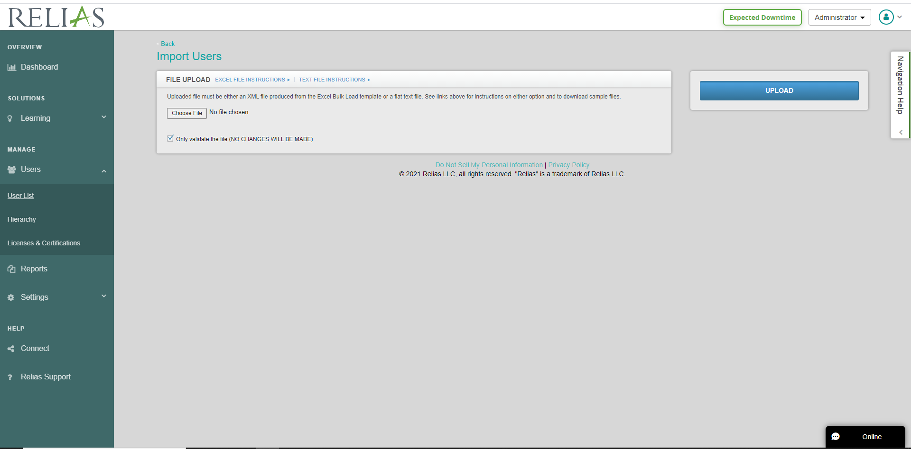
Uploading the excel sheet
Click the “Users” tab to the left
Click the “User List” tab below
Click “Import Users” in the middle of the page
Choose your saved excel file under “Choose File” and it will populate into the page
If you want to validate that all fields are entered correctly, keep the “Only Validate” box checked. Click Upload.
If you want to upload, uncheck the “Only Validate” box. Click Upload.

Slide 17
Conclusion- THANK YOU!
This guide should be a good start to introducing the basic skills necessary for utilizing the Relias Learning platform. Thank you for choosing ICM and Relias for your training needs.
For more information please contact:
Rapheaele Williams, Assistant Director
Email: Rapheaele.Williams@ICM-INC.org
Cell: 501-517-6423
Kevin Liang, Project Director and General Counsel
Email: Kevin.Liang@ICM-INC.org
Cell: 501-351-0339

