Slide 1


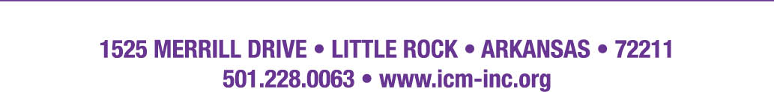
ICM Basic Field Guide for Relias Users
Congratulations on choosing ICM and Relias on fulfilling your employee education and development needs

Slide 2
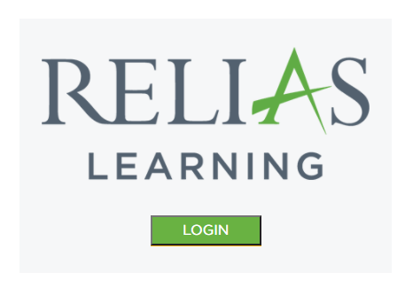
Basic Access for Learners
Basic access to Relias begins with accessing the Relias client page found at https://www.relias.com/clients.
Proceed to click on the “Relias Learning” Icon
After clicking on the Relias Learning Icon, please proceed to log into the Relias system with the username and the password that was sent to you initially. This is commonly your first [space] last name followed with the password of “Welcome1!”

Slide 3
Passwords and Usernames Are Important!
After logging into the system for the first time and entering your username and password (User: First name [space] last name/ Password: Welcome!1), you will be prompted to change your password for future access to your Relias account.
Make sure to write down the new password somewhere you will not forget to look for use next time.
If you cannot locate your password, please contact your supervisor or an account administrator to reset the password for you. They are the only ones that can reset your password for you.

Slide 4
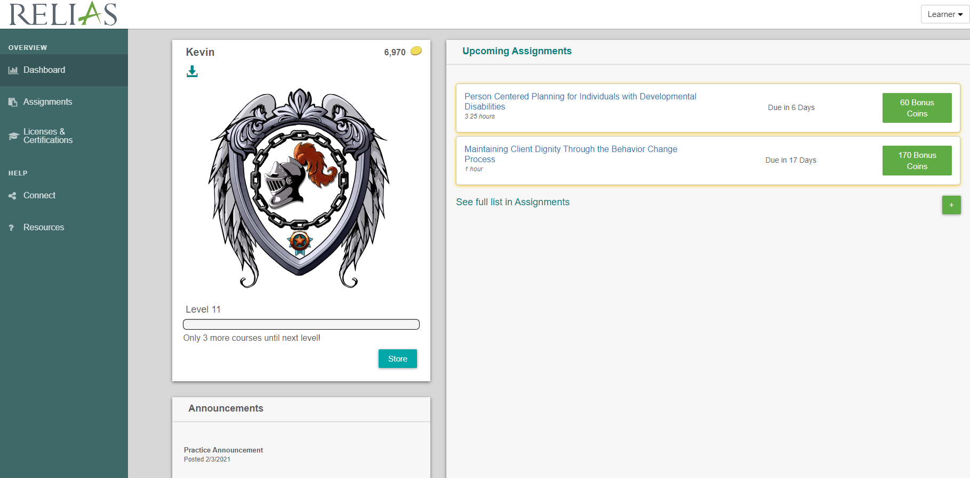
Learner Page
- The learner page is the page that will be your home base and you can track all your assignments and progress.
- From here you can access all your upcoming assignments, progress, certificates, and help resources.
- Always make sure to check for new announcements below your profile.

Slide 5
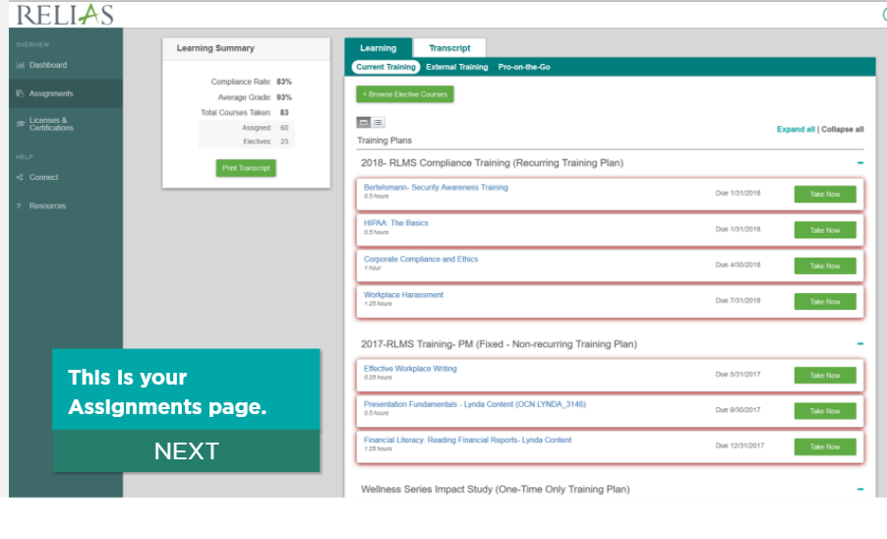
Accessing the Assignments Page

Slide 6
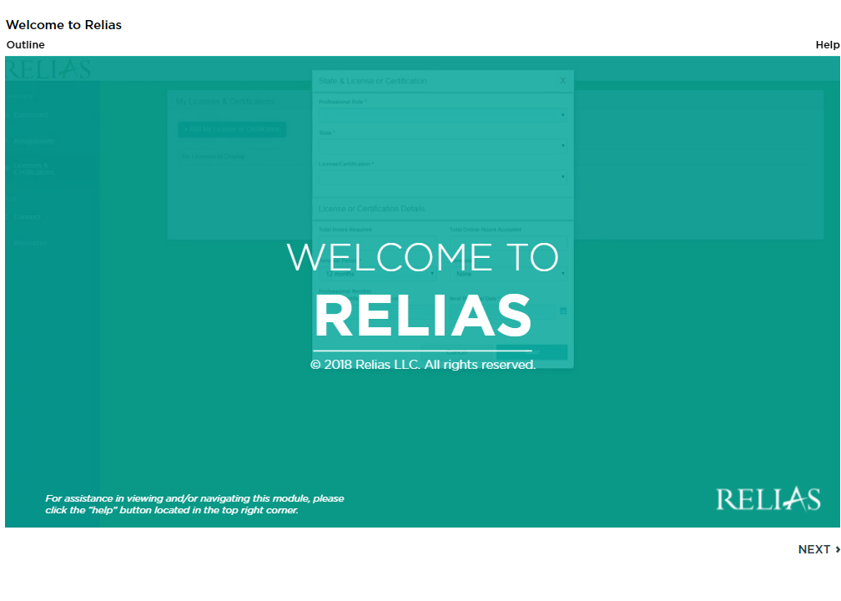
First Course: Welcome to Relias
Please access the course titled “Welcome to Relias” as your first course. This program will teach you all the essential skills needed to use the Relias Learning program.
Some essentials lessons in this course include:
  - Changing your password.
  - Storing license/ certification information.
  - Completing courses.
  - Printing certificates from courses.

Slide 7
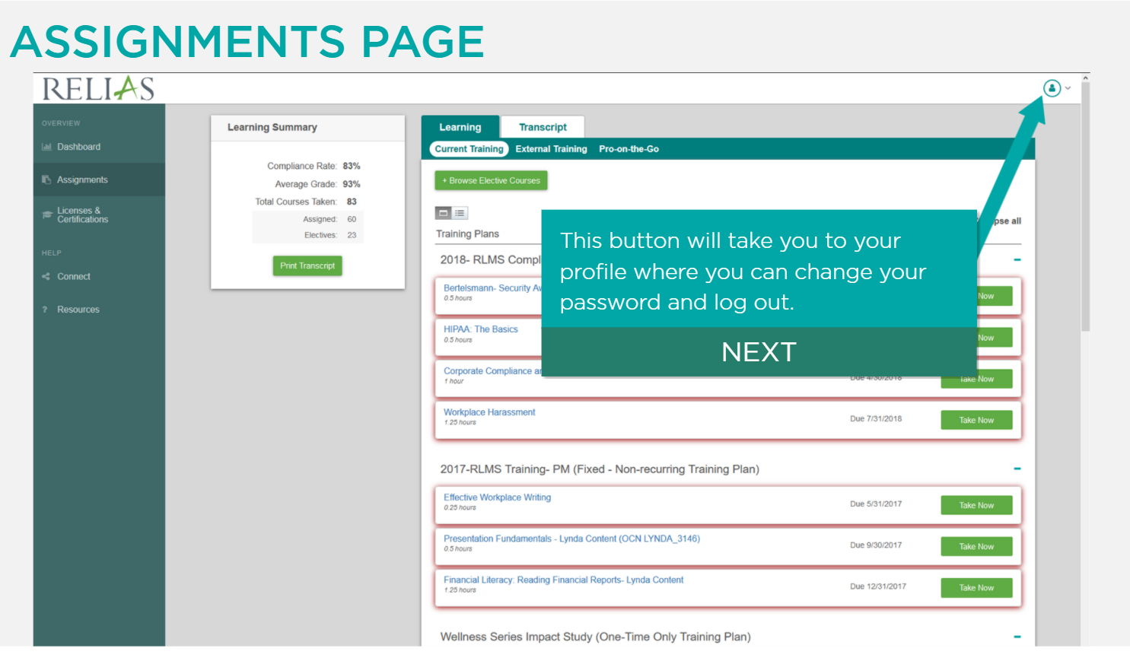
Assignments Page and Profile Access

Slide 8
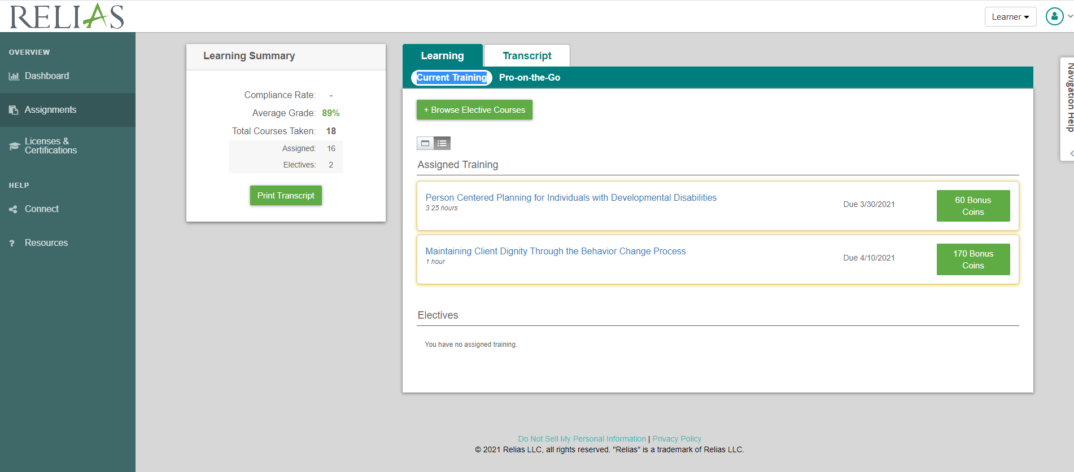
Only Access Current Training and Assigned Training.
Click on the blue highlighted box titled “Current Training” and then click on the Assigned Training course you want to take.

Slide 9
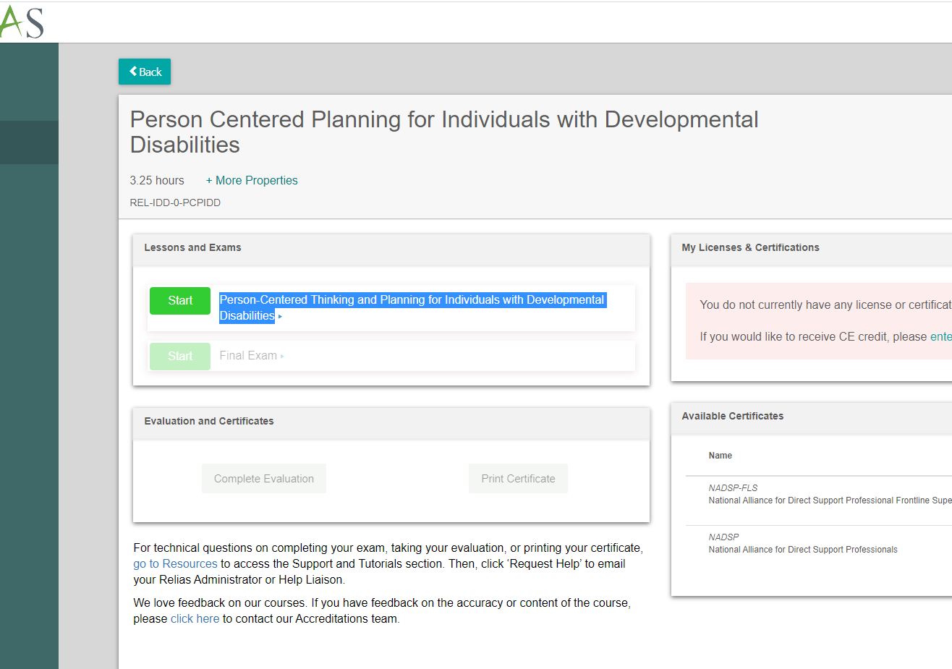
Launching Your Course
Click start or the name of your course to begin taking the course.
Remember that you will need to complete the final exam after taking the course and the evaluation to receive full credit for completion.

Slide 10
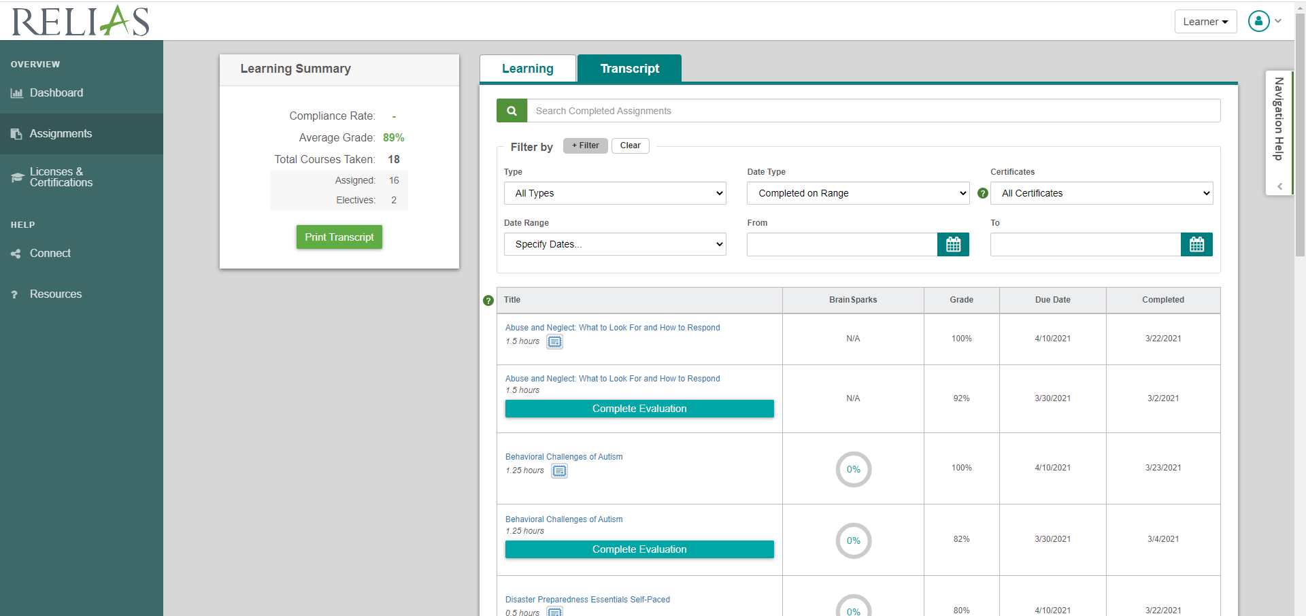
Transcript Access
Click on the Assignments tab to the left to access the assignments page.
Click on the Transcript tab to see the full list of courses you have taken, and any necessary action items needed for completion of the course.

Slide 11
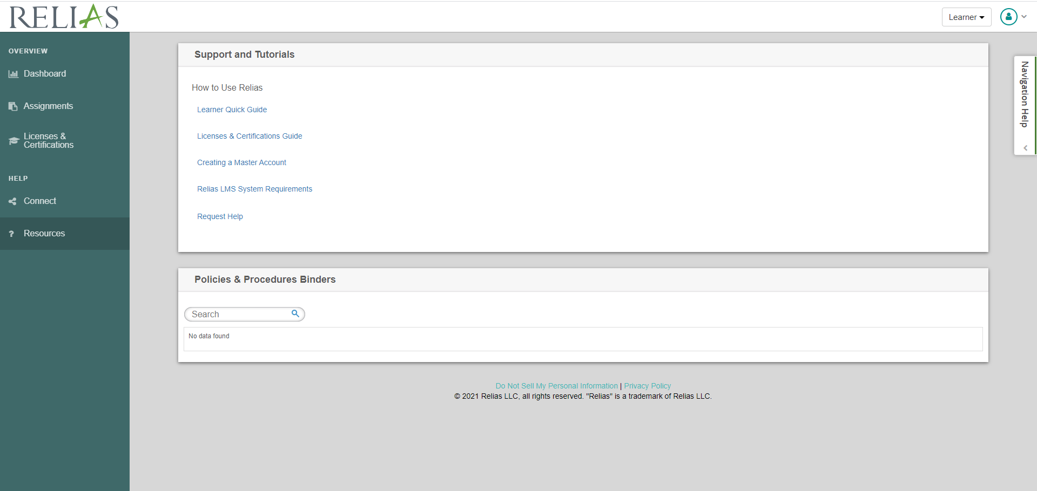
Basic Support and Tutorials
Basic Support and Tutorials can be accessed to the left side of your homepage with the link titled Resources.

Slide 12
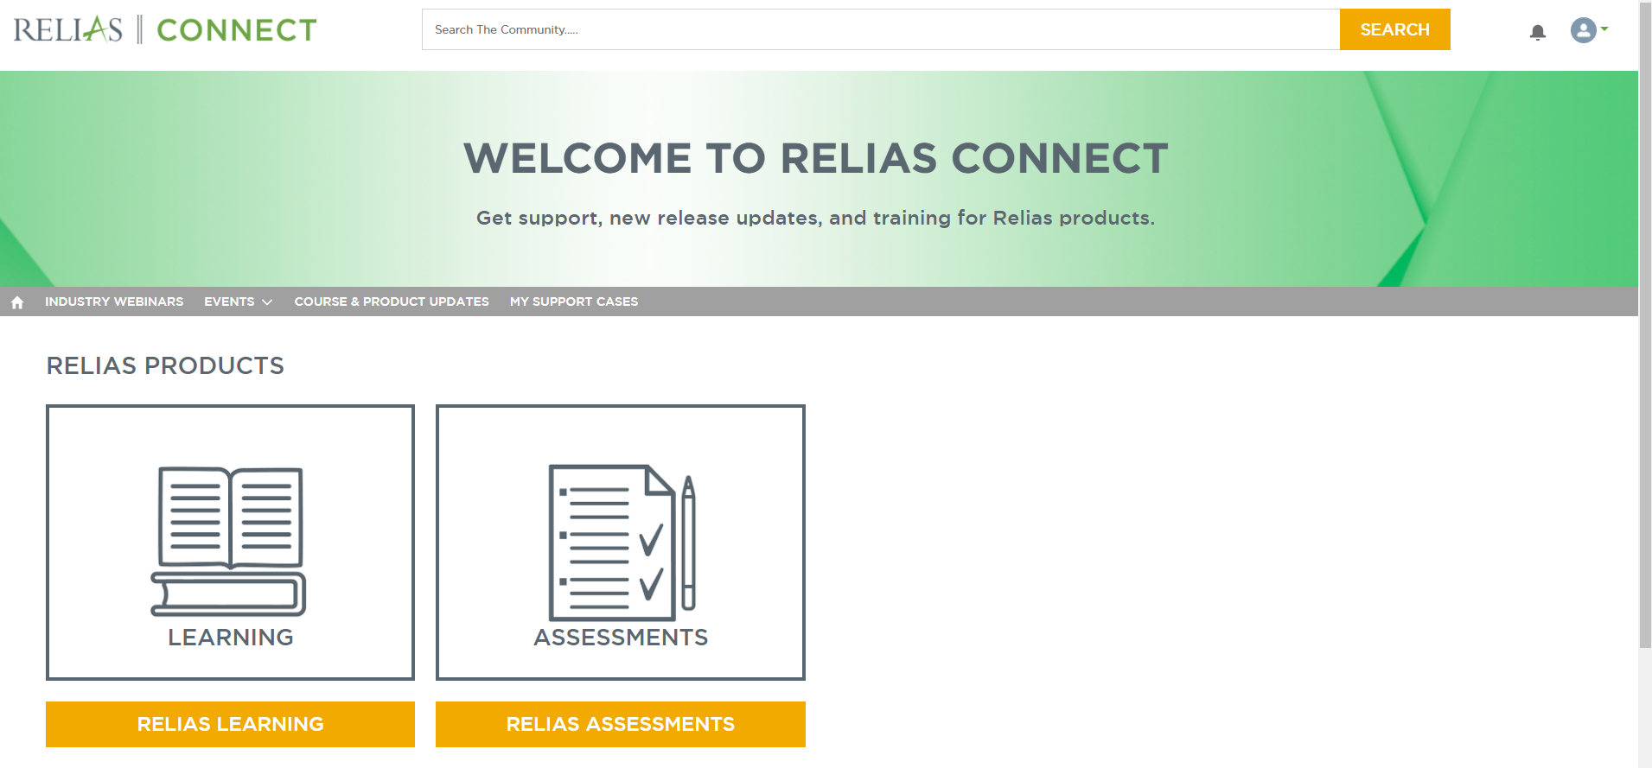
Any Further Questions? Use Relias Connect!
If you have any additional questions, access Relias Connect on the bottom left of your user dashboard page.
This page can answer all questions you might have about using the Relias Learning system.

Slide 13

Thank you for choosing ICM and Relias, we wish you great success in your professional development needs!

